Slide 1


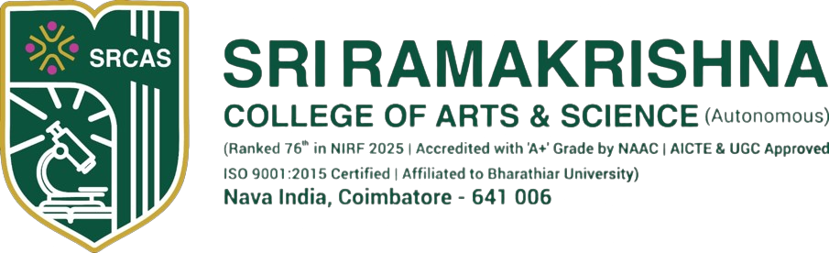
A Voice Tool For Deaf And Hearing
Communities
Done By
Keerthivasan S
23106091
III Bsc cs shift 2
Sri Ramakrishna College of Arts and Science
Under The Guidance Of
Dr.N.Mahendiran
Assistant professor
Sri Ramakrishna College of Arts and Science

Slide 2


Abstract
This project presents a Voice-to-Sign Language Translator that converts spoken English into corresponding sign language gestures using a curated word-level sign language video dataset. The system is designed to bridge communication gaps between hearing individuals and the Deaf community by enabling real-time translation of voice commands into sign language animations. The application integrates a speech recognition module to accurately transcribe spoken words, followed by a gloss-matching engine that identifies the appropriate sign videos from the dataset. The selected sign videos are then displayed instantly on a web-based chatbot-style interface, ensuring smooth and natural interaction. The system avoids storing video outputs on the server, focusing instead on efficient streaming for enhanced performance. This work demonstrates a practical, scalable, and accessible approach to assistive communication technology, showcasing the potential of AI-driven multimodal translation tools in inclusive digital environments.

Slide 3
Introduction
This project focuses on creating a Voice-to-Sign Language Translator that converts spoken English into sign language gestures in real time. By combining speech recognition with a curated sign video dataset, the system allows users to speak naturally and instantly view the corresponding sign animations on a web interface. The tool aims to support communication between hearing individuals and the Deaf community through an accessible and efficient AI-powered solution.

Slide 4
Existing system
Existing communication systems between hearing and non-hearing individuals are limited in the following ways:
No real-time translation between speech and sign language.
Many tools rely only on text-to-sign, not voice-to-sign.
Existing apps often use GIF-based or low-quality sign animations, lacking accurate SL gesture mapping.
Manual interpretation through human sign-language interpreters is required in many scenarios.
Most available systems do not utilize large datasets like WLSL, which contains thousands of SL videos.
Limited accessibility tools for education, hospitals, classrooms, and public communication.
These limitations highlight the need for a more efficient and automated voice-to-sign translation system.

Slide 5
Proposed solution
The proposed system provides an automated pipeline that:
1. Captures user’s voice through a microphone.
2. Converts speech to text using ASR (Automatic Speech Recognition) such as Google Speech API or Vosk.
3. Extracts keywords and matches them with corresponding glosses in the WLSL dataset.
4. Streams the sign-language videos instantly in the user interface without storing them on the backend.
5. Displays videos in a chatbot-style UI, making the system interactive and user-friendly.

Slide 6

Software requirements
Frontend | Backend | Tools
HTML/CSS/JS, | Python 3.9+ | VS Code,Cursor
MediaRecorder API | Google Speech | Browser
Video playback | OpenCV | Postman

Slide 7
Hardware Requirements
Processor: Dual-core CPU
RAM: 4GB
Storage: 2GB (for project code & dataset subset)
Microphone: Any standard USB/embedded microphone
System: Laptop/PC capable of running Python

Slide 8
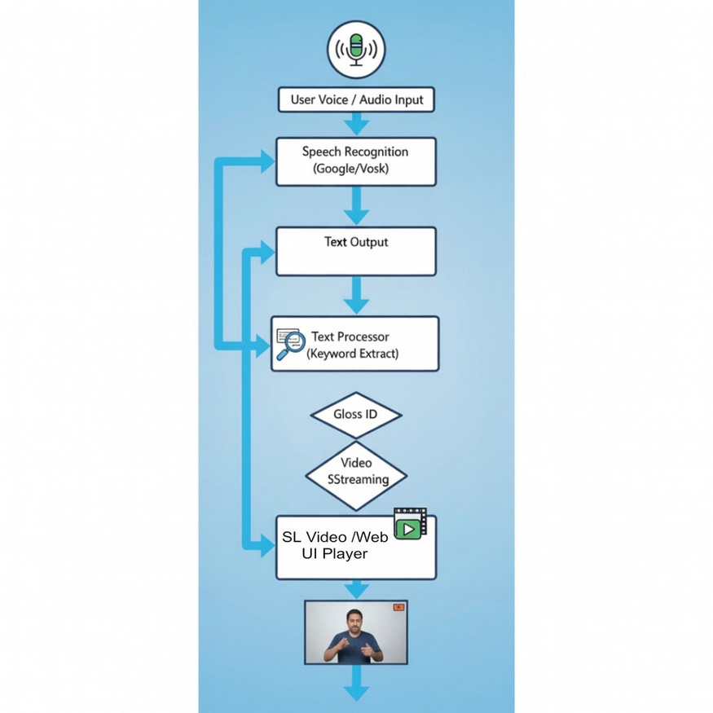
Data Flow diagram

Slide 9
Conclusion
The developed system successfully demonstrates how voice input can be translated into sign language animations using AI and a structured video dataset. Its real-time performance, efficient streaming, and easy web-based interaction make it a practical tool for inclusive communication. This work highlights the potential of AI-driven translators to improve accessibility and support the Deaf community in everyday interactions.

Slide 10
Thank you!

